Slide 1

Sales prediction model

Slide 2
About the model
Purpose Of The Model: The primary objective of the sales prediction model is to forecast future sales based on historical data.
Application In Machine Learning: It helps in various aspects such as inventory management, budget planning, and marketing strategies. Predicting sales accurately is crucial for optimizing operations and reducing costs within a business.

Slide 3
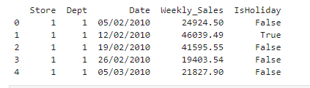
Dataset used The dataset was obtained from the Kaggle repository
The sales dataset consists of 421,570 entries.
Features:
Store: The store number (integer).
Dept: The department number within the store (integer).
Date: The week of the sales data (string format).
Weekly_Sales: The sales for the given department in the given store (float).
IsHoliday: Whether the week is a special holiday week (boolean).

Slide 4

Data preprocessing
Date Conversion: The Date column was converted from string format to datetime, which is crucial for any time series analysis.
Sales Adjustment: Negative sales values were corrected to zero, ensuring that the data reflects realistic sales scenarios.
Train-Test Split: Data was split into 80% training and 20% testing subsets for evaluation.

Slide 5

Exploratory data analysis (eda)
A line plot was created for a subset of stores (1, 2, and 3) showing weekly sales over time. This plot helps visualize trends and seasonal effects in sales across different stores.
Sales Over Time by Store:
A bar plot was used to display the total sales for each store, identifying which stores contribute most to overall sales.
Total Sales Distribution Across Stores:
A comparative bar plot was generated to compare average weekly sales during holidays versus non-holidays, highlighting the impact of holidays on sales performance.
Holiday Impact on Sales:

Slide 6
Feature engineering
Adding a 'Year' column extracts annual trends, beneficial for analyzing growth or declines in sales data.
The 'Month' column helps identify monthly sales patterns and seasonal effects like holiday or summer sales spikes.
The 'Week' column captures ISO week numbers, enabling detailed weekly analysis for trends like paydays or promotions.
Converting 'IsHoliday' to integers facilitates use in ML algorithms, simplifying categorical data handling and analysis.

Slide 7

Algorithm used
A Random Forest Regressor was chosen for the model, which is suitable for handling nonlinear relationships and interactions between features without extensive hyperparameter tuning or scaling of the data.
Non-Linear Relationships: Handles complex interactions and non-linear relationships between variables effectively.
Resistant To Overfitting: Robust to overfitting, especially with many features and diverse data from multiple stores.
Insights Into Feature Importance: Provides important feature insights, aiding in understanding factors influencing weekly sales predictions.

Slide 8
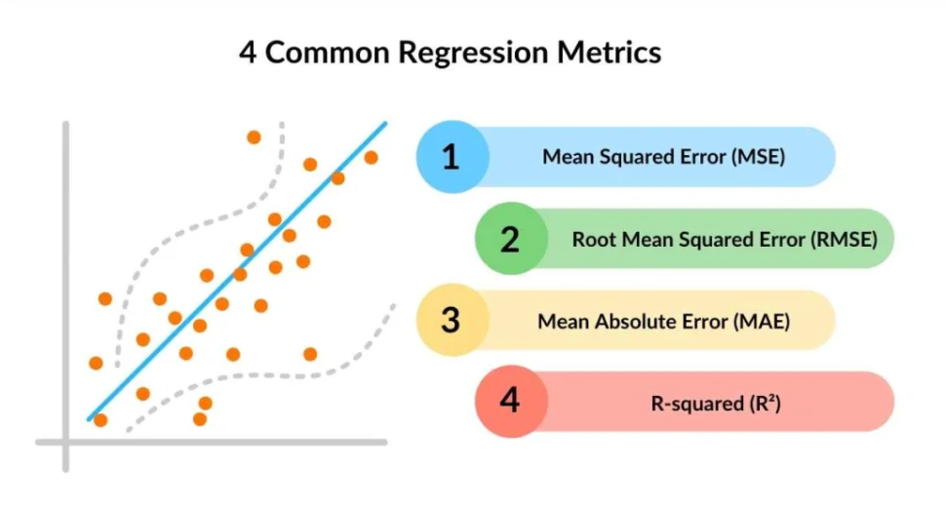
Model performance
Mean Squared Error (MSE):
Training MSE: 20,171,200.72 - Indicates the model fits the training data well with low error.
Test MSE: 23,565,649.06 - Slightly higher on the test set, suggesting minor overfitting but still relatively low.
Coefficient of Determination (R² Score):
Training R²: 0.96 - Demonstrates that the model explains 96% of the variance in the training dataset.
Test R²: 0.95 - Shows consistency, explaining 95% of the variance in the test dataset, indicating good generalization.

Slide 9
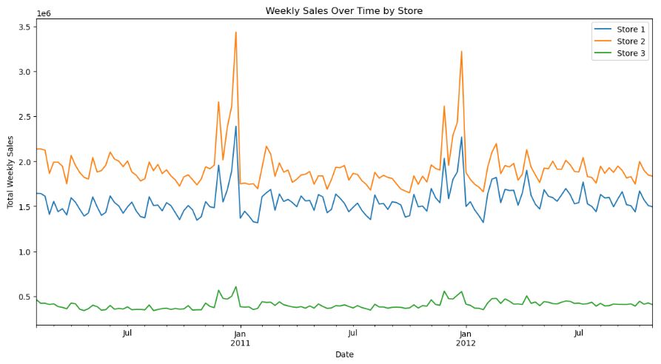
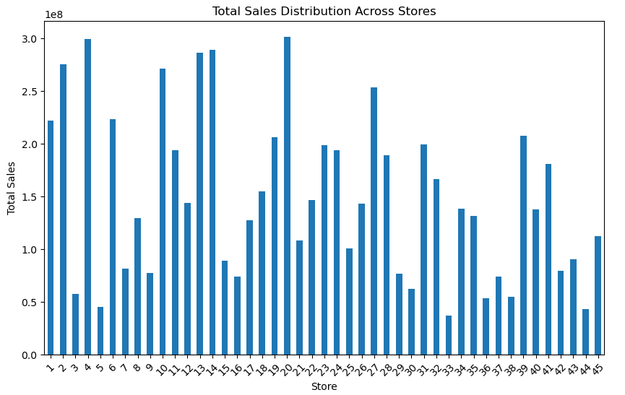
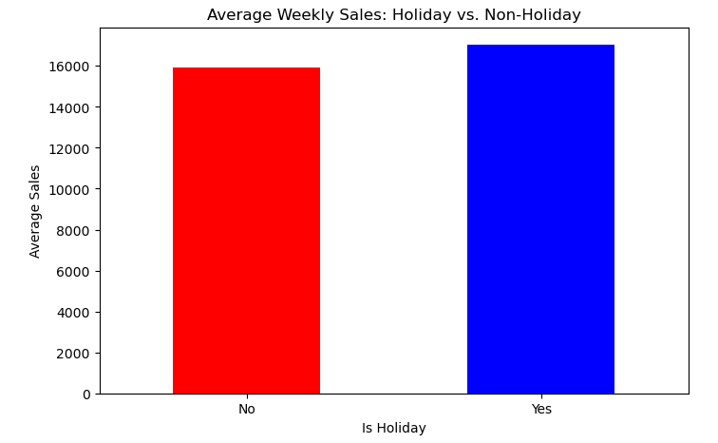
Plot interpretation
Weekly Sales Over Time By Store
Total Sales Distribution Across Stores
Average Weekly Sales: Holiday vs. Non-Holiday
Seasonal Trends: Sales peak around major holidays, notably December and January.
Store Comparison: Stores 1 and 2 perform similarly; Store 3 significantly lags.
Sales Volatility: Sharp spikes suggest major impacts from promotions, needing analysis.
Sales Variation Across Stores: Significant performance variation among stores; some outperform others.
High Performers and Low Performers: Some stores excel, others lag; management strategies needed.
Strategic Insights for Management: Data directs strategic decisions for store expansion and improvements.
Holiday Sales Impact: Holidays show no significant boost in sales compared to non-holidays.
Strategic Planning: Lack of holiday sales impact suggests need for better promotions.
Further Analysis Needed: Requires deeper investigation into holiday types and regional sales strategies.

Slide 10
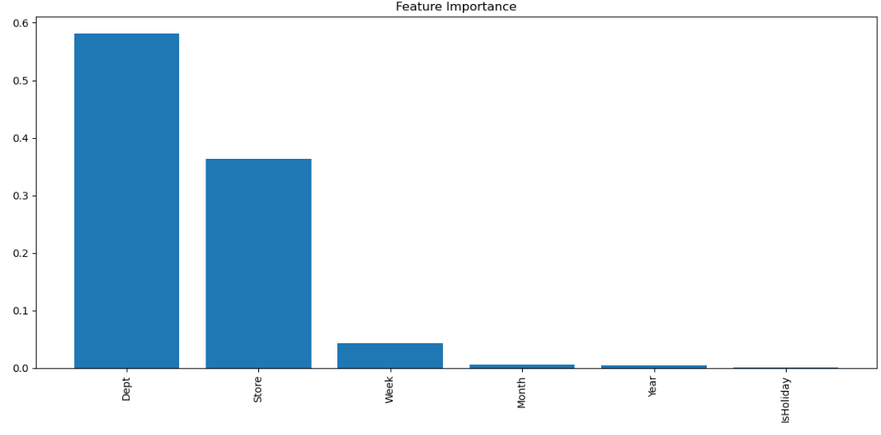
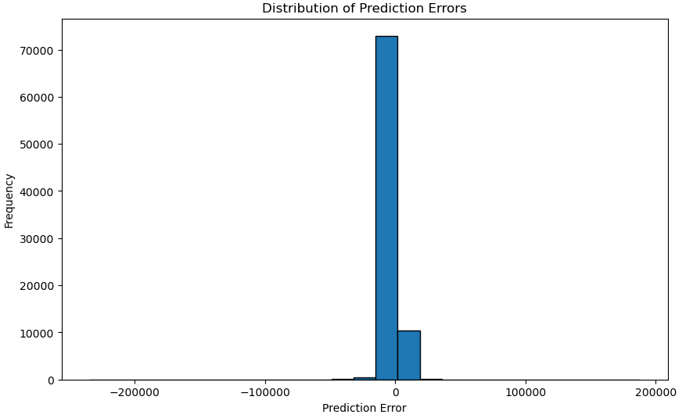
Plot interpretation
Feature Importance
Distribution Of Predicted Errors
Department Dominance: 'Dept' is the top predictor of sales, reflecting product and preference impacts.
Store Significance: Store location and demographics notably influence sales, showing significant importance.
Temporal Features Less Critical: Time-related features like week and month show minimal impact on sales.
Central Error Concentration: Most prediction errors cluster around zero, indicating accurate model predictions.
Small Error Frequency: Few large errors, with most data showing minimal prediction discrepancy.
Symmetric Error Distribution: Error distribution appears symmetric, suggesting unbiased model performance.

Slide 11
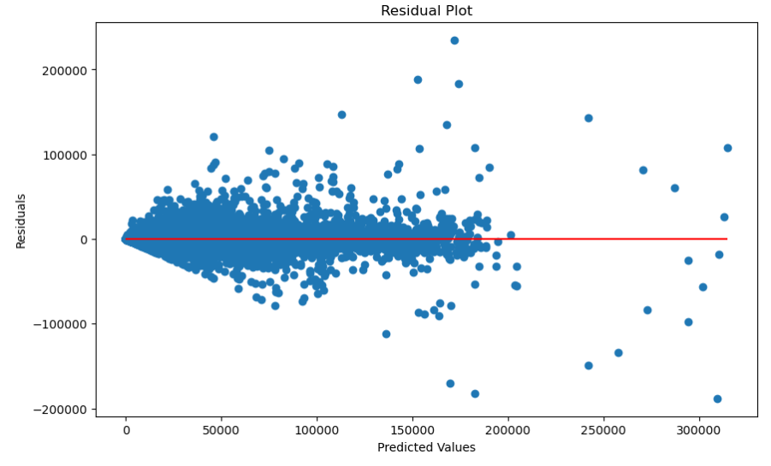
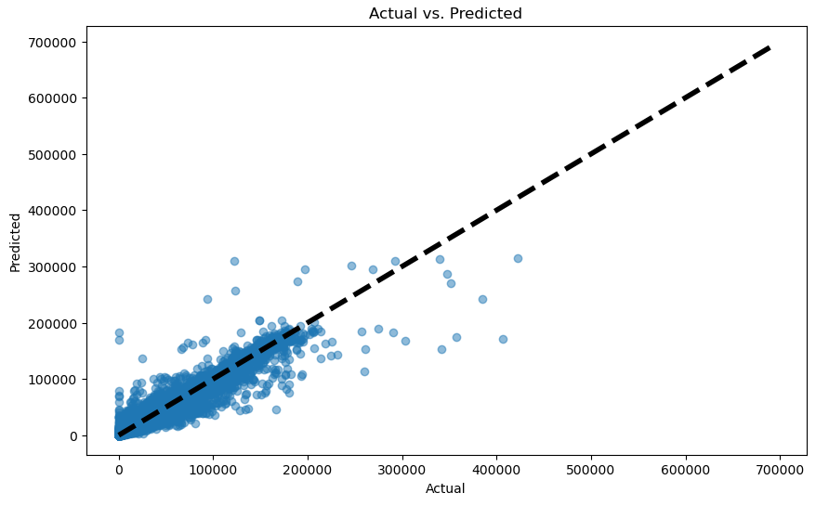
Plot interpretation
Residual plot
Actual vs Predicted
Residual Spread: Residuals centered around zero, showing generally good model predictions across values.
Increasing Variance: Residual variance increases with higher predicted values, indicating potential heteroscedasticity.
Outliers Presence: Some large residuals suggest outliers or model misspecifications at high prediction levels.
Close Alignment: Data clusters near line; model accurately predicts lower to mid-range values.
Deviation at Extremes: Larger discrepancies appear as actual values increase; model struggles with high values.
Overall Good Fit: Most predictions closely align with actual values, indicating effective model performance.

Slide 12
Thank you

